Slide 1
Consumer Behaviour
A European Perspective Seventh Edition
Part A
Consumers in the marketplace
Chapter 1
Consumer behaviour and consumer society

Slide 2
Consumer behaviour: people in the marketplace
We use products to help us define our identities in different settings.
The average consumer’s purchase decisions are heavily influenced by the opinions and behaviour of their family, peers and acquaintances.
As a member of a large society, consumers share certain cultural values or strongly held beliefs about the way the world should be structured.
Brands have clearly defined images or ‘personalities’ in order to appeal to specific segments of the market
The images or ‘personalities’ of brands are created by product advertising, packaging, branding and other marketing strategies that focus on positioning a product in a certain way.
When a product succeeds in satisfying a consumer’s specific needs or desires, it may be rewarded with many years of brand loyalty.

Slide 3
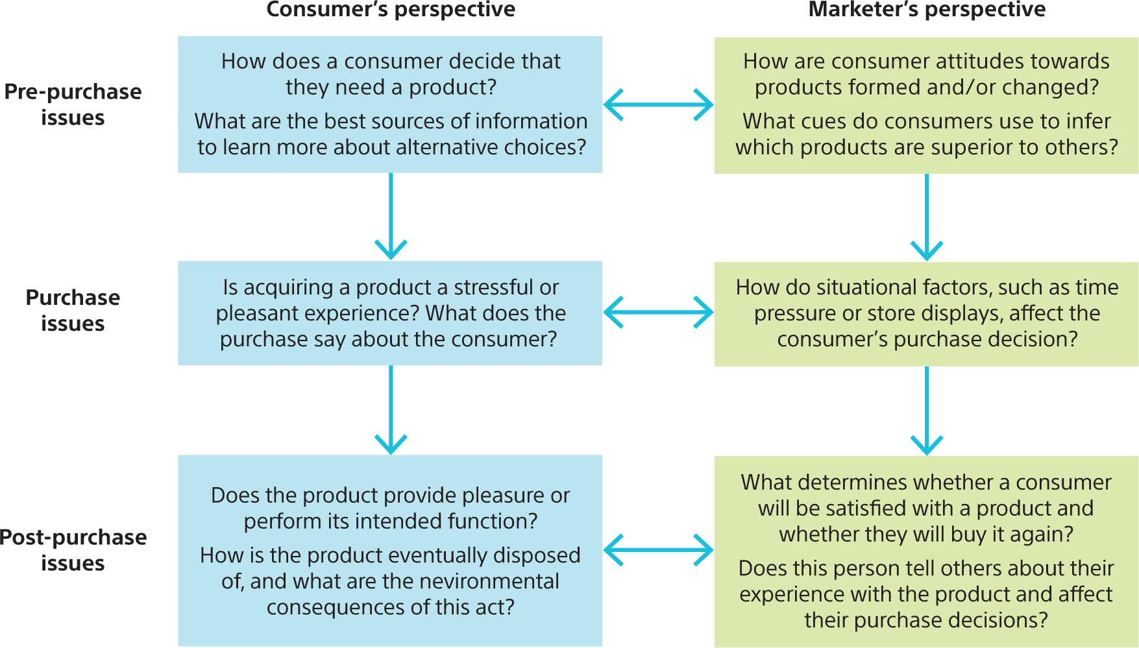
Figure 1.1 Some issues that arise during stages in the consumption process

Slide 4
Consumer research and marketing strategy
Very simply, understanding consumer behaviour is good business. A basic marketing concept states that firms exist to satisfy needs.
The process of market segmentation identifies groups of consumers who are similar to one another in one or more ways while at the same time they are different from members of other segments.
While consumers can be described in many ways, the segmentation process is valid only when the following criteria are met:
Consumers within the segment are similar to one another in terms of product needs, and these needs are different from consumers in other segments.
Important differences among segments can be identified.
The segment is large enough to be profitable.
Consumers in the segment can be reached by an appropriate marketing mix.
The consumers in the segment will respond in the desired way to the marketing mix designed for them.

Slide 5
Consumer behaviour as a field of study
Consumer behaviour may be studied from many points of view – such as psychology, sociology, social psychology, cultural anthropology and economics.
Many regard the field of consumer behaviour as an applied social science. Accordingly, the value of the knowledge generated should be evaluated in terms of its ability to improve the effectiveness of marketing practice.
One general way to classify consumer research is in terms of the fundamental assumptions that the researchers make about what they are studying and how to study it. This set of beliefs is known as a paradigm.
The dominant paradigm is called positivism (or sometimes called modernism). It emphasises that human reason is supreme, and that there is a single, objective truth that can be discovered by science. Positivism encourages us to stress the function of objects, to celebrate technology and to regard the world as a rational, ordered place with a clearly defined past, present and future.
The emerging paradigm of interpretivism (or postmodernism) questions the above assumptions.

Slide 6
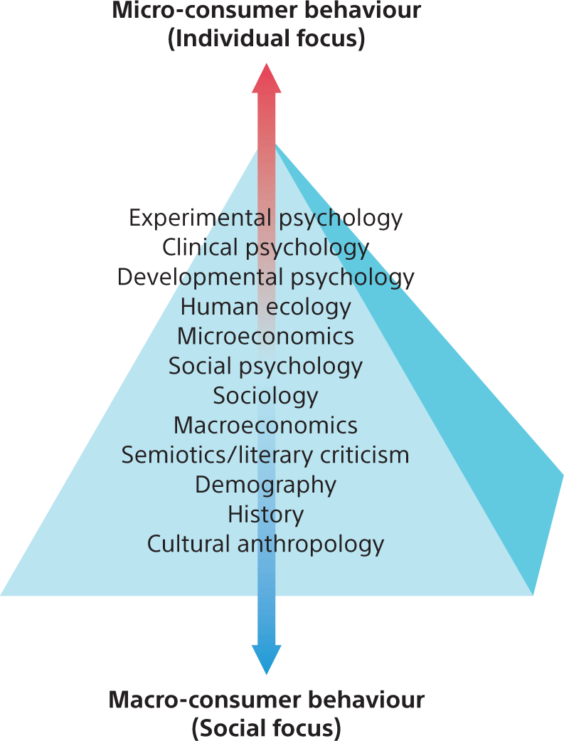
Figure 1.2 The pyramid of consumer behaviour

Slide 7
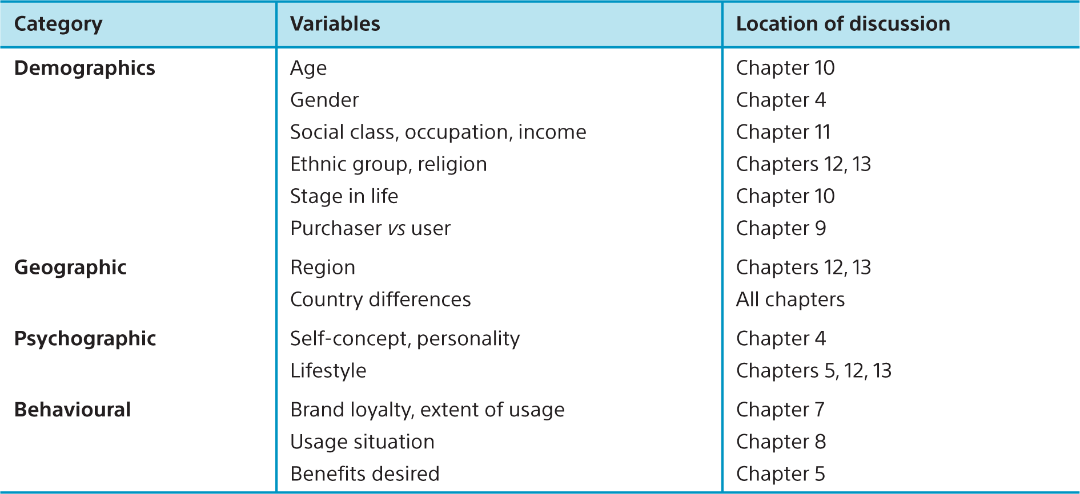
Table 1.1 Variables for market segmentation

Slide 8
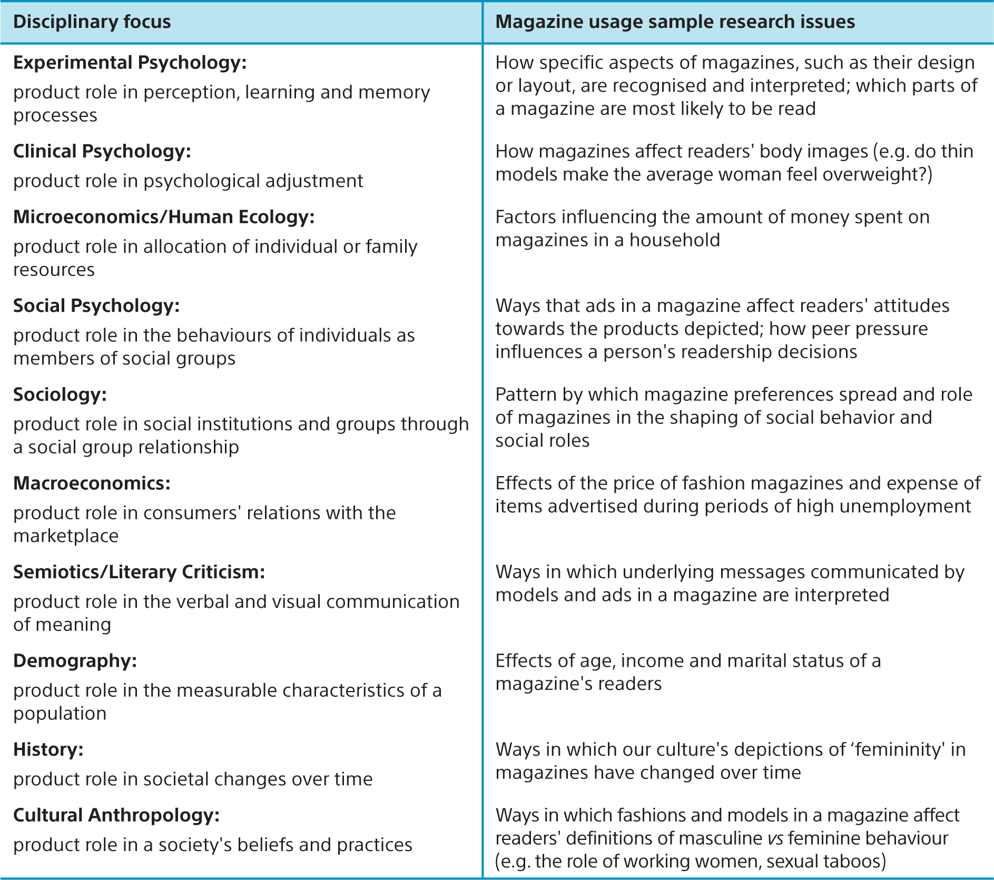
Table 1.2 Interdisciplinary research issues in consumer behaviour

Slide 9
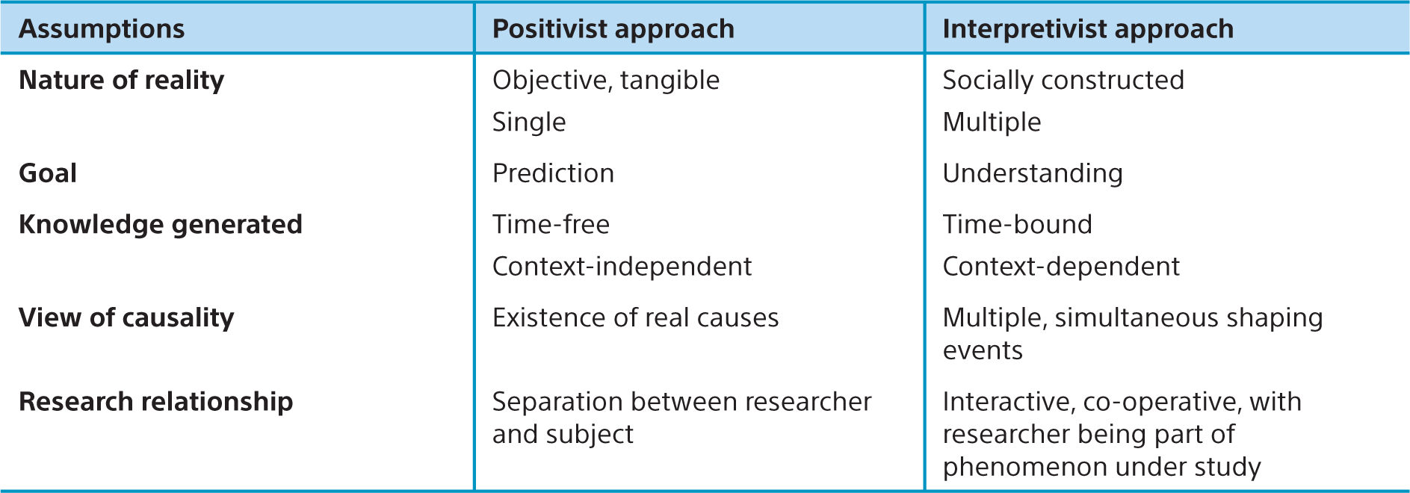
Table 1.3 Positivist vs interpretivist approaches to consumer behaviour
Source: Adapted from Laurel A. Hudson and Julie L. Ozanne, ‘Alternative ways of seeking knowledge in consumer research', Journal of Consumer Research 14(4) (1988): 508–21.
Copyright © 1988, Oxford University Press by permission of Oxford University Press.

Slide 10
Consumer culture
When it is said that contemporary culture is a consumer culture, we do not only refer to the central role of consumption in all of our daily activities. We also underline the basic relationship between market forces, consumption processes and the basic characteristics of what we normally understand by ‘a culture’.
A lot of our everyday imaginations are informed by consumer culture – our imaginations about health, perfect family life, the dream wedding take shape using consumer culture as negative or positive frames of reference.
In times of economic crisis, consumers are time and again called upon for playing their crucial part in keeping the economies running. The standard economic logic is that if consumers stop buying, producers will have to stop producing.
Popular culture, that is the music, films, sports, books and other forms of entertainment consumed by the mass market, is both a product of and an inspiration for marketers.

Slide 11
Global consumer culture
The process of globalisation refers to the mingling of local and foreign products and practices and has attracted a tremendous amount of interest in the last couple of decades.
Learning about the relationship between the global and the local in the practices of other cultures is more than just interesting – it is an essential task for any company that wishes to expand its horizons and become part of the international or global marketplace at the beginning of the new millennium. Two views exist:
An etic perspective, which focuses upon commonalities across cultures (it is objective and analytical). An etic approach assumes that there are common, general categories and measurements which are valid for all cultures under consideration.
On the other hand, many marketers choose to study and analyse a culture using an emic perspective, which attempts to explain a culture based on the cultural categories and experiences of the insiders.

Slide 12
A global consumer?
In a large scale study, researchers have grouped consumers into following segments, according to how they evaluate global brands.
Global citizens. The largest segment (55 per cent of consumers) uses the global success of a company as a signal of quality and innovation. At the same time, they are concerned about whether companies behave responsibly on issues such as consumer health, the environment and worker rights.
Global dreamers. The second-largest segment, at 23 per cent, consists of consumers who see global brands as quality products and readily buy into the myths they author. They are not nearly as concerned with social responsibility as are the global citizens.
Antiglobals. Thirteen per cent of consumers are sceptical that transnational companies deliver higher-quality goods. They dislike brands that preach American values and do not trust global companies to behave responsibly. They try to avoid doing business with transnational firms.
Global agnostics. The remaining 9 per cent of consumers don’t base purchase decisions on a brand’s global attributes. Instead, they evaluate a global product by the same criteria they use to judge local brands and don’t regard its global nature as meriting special consideration.

Slide 13
Politics of consumption
Consumption is not just a private but also a political issue.
Public concern for the welfare of consumers has been an issue since at least the beginning of the twentieth century.

Slide 14
Dark sides of consumer culture
Many critics have attacked consumer society for a variety of reasons: that it erodes cultural differences, that it creates superficial and inauthentic forms of social interaction and that it inspires competition and individualism rather than solidarity and community.
The pressure of consumer society is not only felt on the environment but also on the individual consumer, sometimes with negative outcomes.
Compulsive buying is a physiological and/or psychological dependency on products or services.
The central role of consumption in today’s society has also led to an increasing interest in the social and political consequences of consumer society.
Some critics have coined the term affluenza to account for the negative sides of a society over-focused on its consumption.

Slide 15
Table 1.4 Political consumption activities among food consumers in four European countries (percentage of population) (all result: p = < 0.0001)
Source: Adapted from Bente Halkier et al., ‘Trusting, complex, quality conscious or unprotected? Constructing the food consumer in different European national contexts’,
Journal of Consumer Culture, 7(3), 2007: 379–402

Slide 16
Summary
We use products to help us define our identities in different settings.
Consumer behaviour is a process involving many actors.
Many different types of specialists study consumer behavior.
There are basically two different perspectives/paradigms regarding how and what we should understand about consumer behavior.
The society we live in today can be described as a consumer society.
Globalisation is important when trying to understand the consumer society.
Consumption is not just a private, but also a political issue.
We are witnessing new forms of collective consumption formats appearing.

