Slide 1
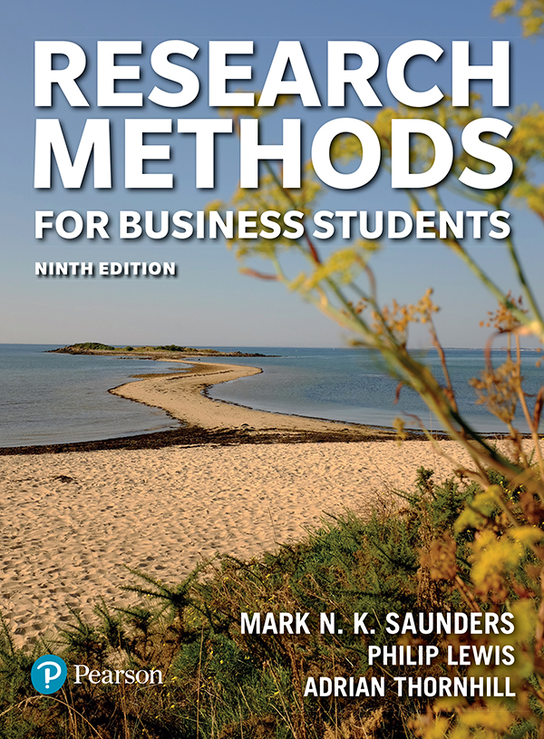
Research Methods
for Business Students
Ninth Edition
Chapter 1
Research, reflective diaries and the purpose of this book

Slide 2
Learning Objectives
By the end of this chapter you should be able to:
define the nature of research;
outline the features of business and management research;
recall the stages you will need to complete (and revisit) as part of your research process;
understand the importance of keeping a reflective diary;
recognise the purpose, structure and features of this book;
progress your research project by starting to make entries in your reflective diary or notebook.

Slide 3
Table 1.1 A taxonomy for considering the ‘relevance gap’ in relation to managerial knowledge
Source: Developed from Hodgkinson et al. (2001)

Slide 4
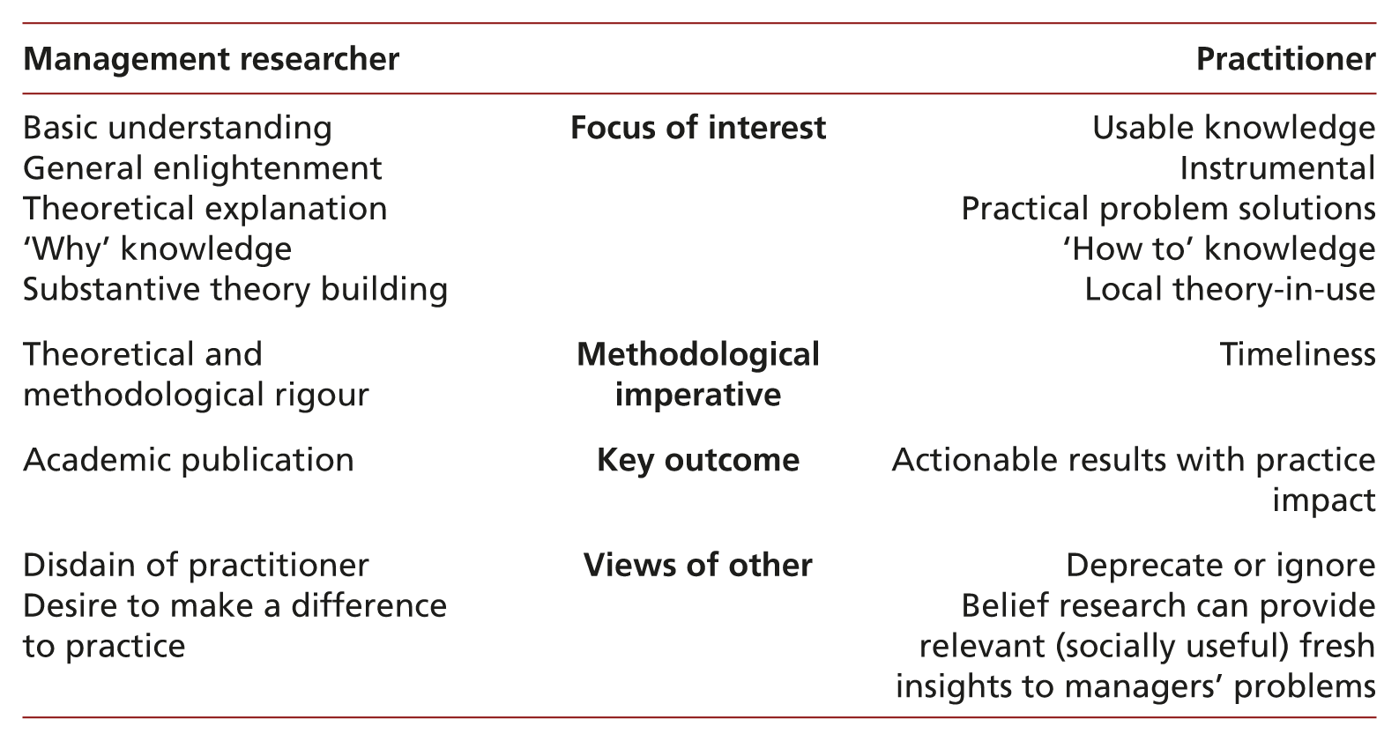
Table 1.2 Practitioner and management researcher orientations
Source: Developed from Saunders (2011)

Slide 5
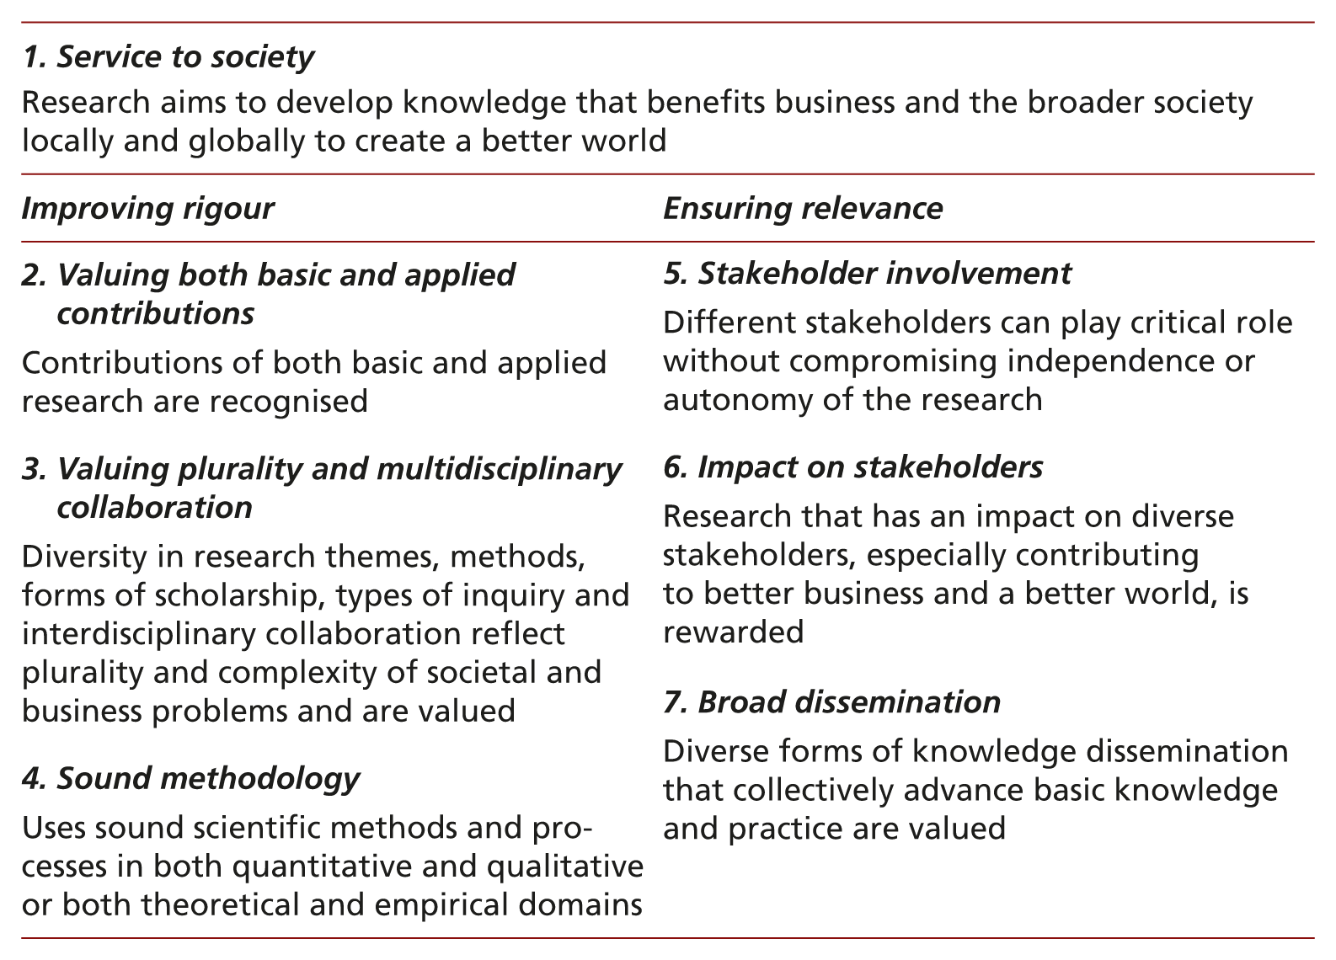
Source: Developed from McKiernan and Tsui (2020)
Notes:
Table 1.3 Community for Responsible Research in Business and Management’s seven principles of responsible research

Slide 6
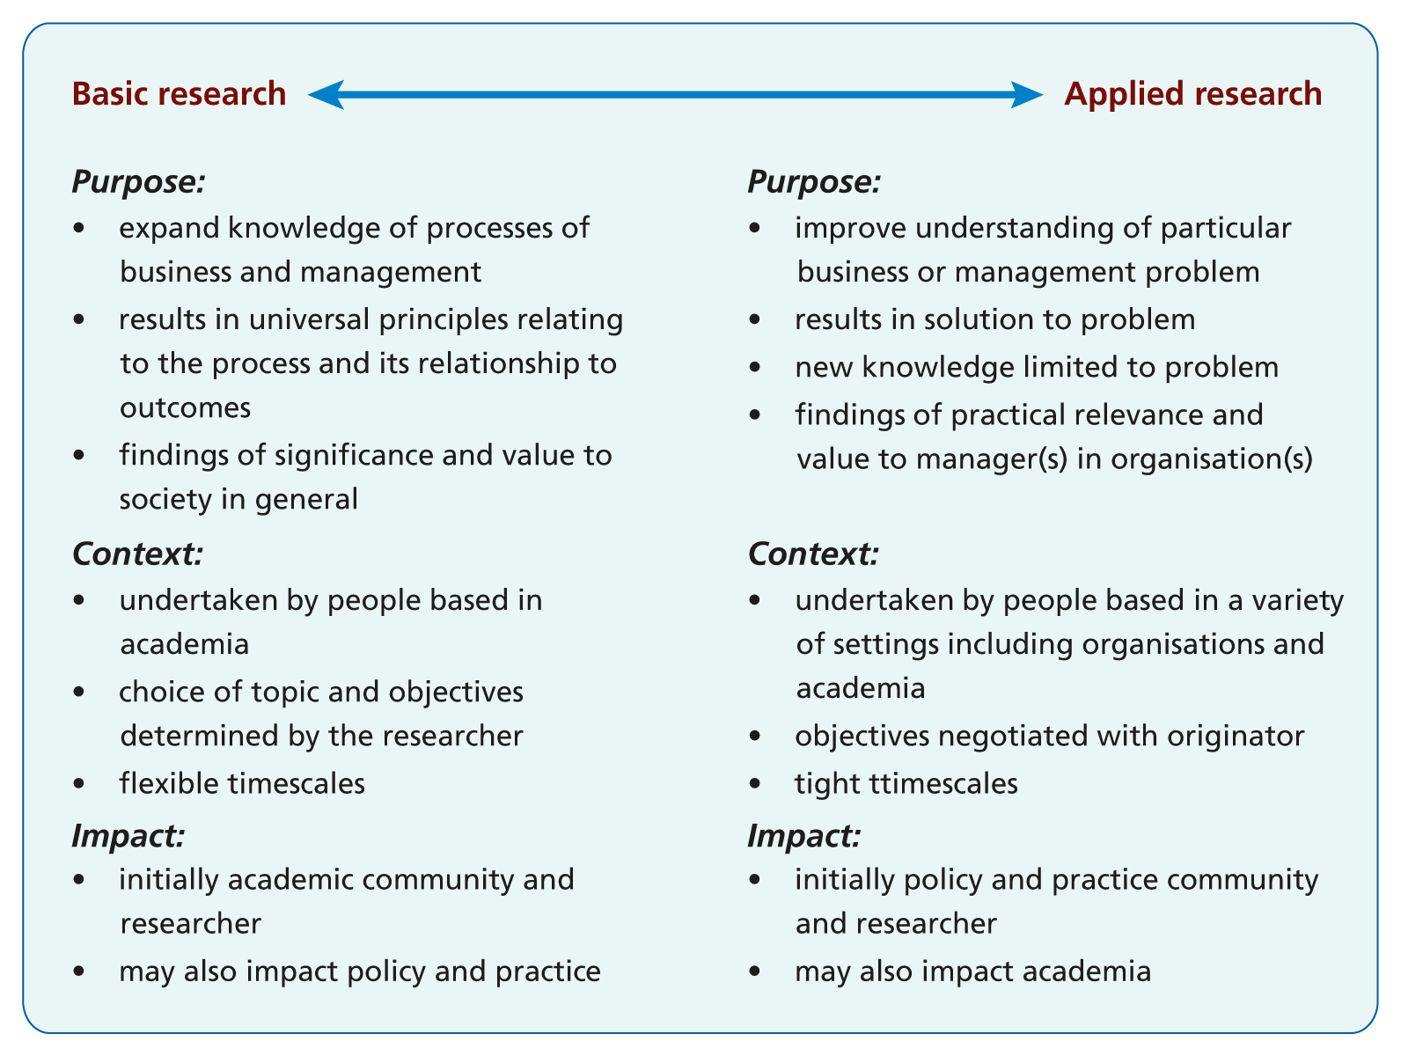
Figure 1.1 Basic and applied research
Sources: Authors’ experience; Easterby-Smith et al. (2021); Hedrick et al. (1993), MacIntosh et al. (2017)

Slide 7
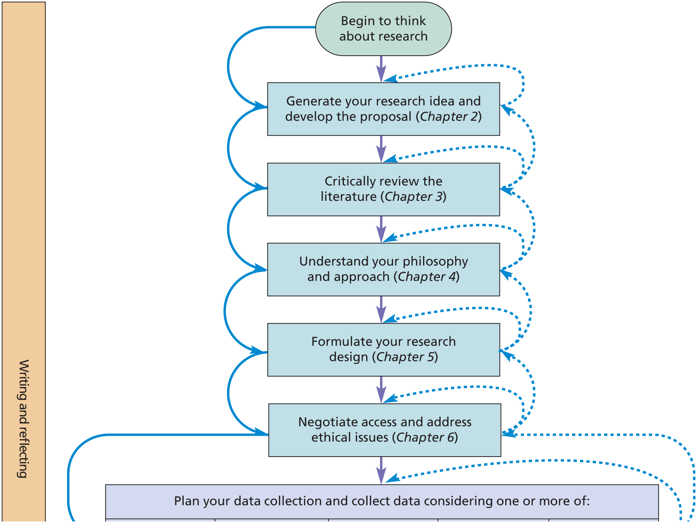
Figure 1.2 The research process (1 of 2)
Source: © Mark Saunders, Philip Lewis and Adrian Thornhill 2022

Slide 8
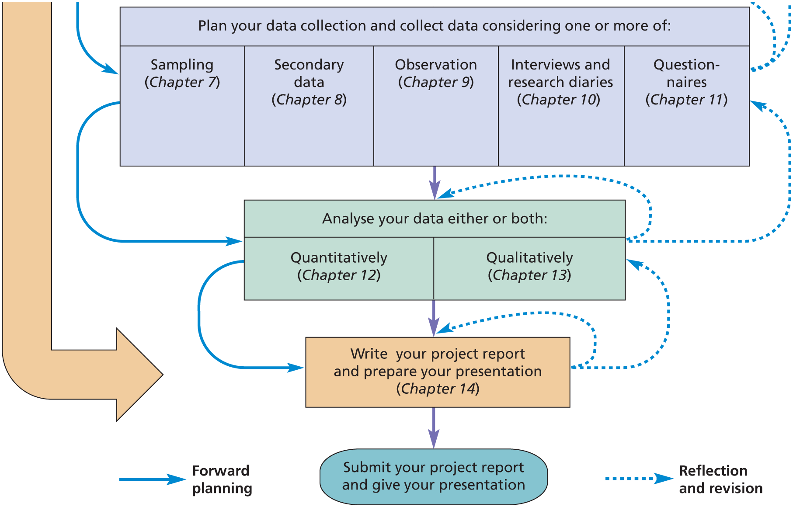
Figure 1.2 The research process (2 of 2)
Source: © Mark Saunders, Philip Lewis and Adrian Thornhill 2022

